Slide 1




GRAYS BROTHERS
Store Sales Dataset Analysis
PREPARED BY:
Ahmed Samir
Ahmed Magdy
Amir Mostafa
Peter Fawzy
Said Abdelwahed

Slide 2

TABLE OF CONTENTS
I. Overview
II. Revenue Analysis
III. Products Analysis
IV. Region Analysis
V. How we built the project
VI. Project Summery

Slide 3
Overview
This project aims to transform raw Superstore sales data into meaningful insights that support strategic decision-making across revenue, product, and regional performance. Using Power BI, we conducted a full data analysis lifecycle—data preparation, modeling, and visualization—to deliver a reliable and interactive reporting solution.
The analysis provides stakeholders with a comprehensive view of business performance, including total revenue, customer behavior, product profitability, and geographic market trends. By structuring the data into a clean star-schema model and creating time-intelligent measures, the dashboard enables deeper exploration of sales patterns over time.

Slide 4


The final Power BI report consists of three main analysis areas:
•Revenue Analysis: Measures overall business performance and highlights the top contributing customers, regions, and customer segments.
•Product Analysis: Identifies high-performing categories, products, and sub-categories to support inventory and product strategy decisions.
•Region Analysis: Breaks down revenue across regions, countries, states, and cities to identify geographic opportunities and areas for improvement.
Revenue Insights
Trends across time, revenue distribution by segments. Identify growth periods and performance drivers.
Product & Regional Insights
Best-selling categories and products. Profitability analysis highlighting top and low performers.
Sales performance across regions identifying high-potential areas. Understand geographic trends.

Slide 5
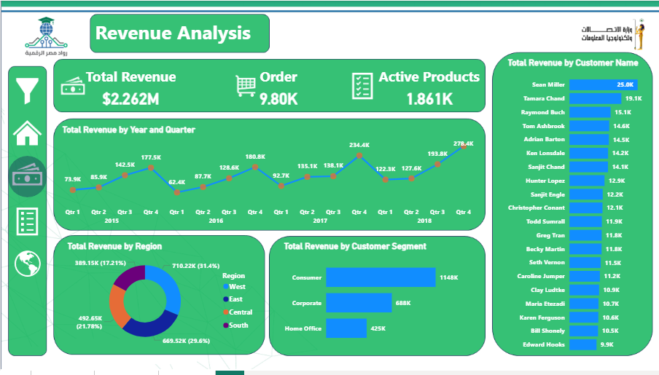
Revenue Analysis
VISION
Measures overall business performance and highlights the top contributing customers, regions, and customer segments.

Slide 6
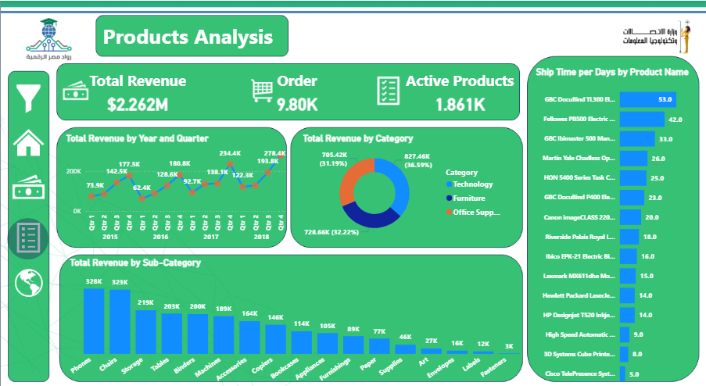
Products Analysis
VISION
Identifies high-performing categories, products, and sub-categories to support inventory and product strategy decisions.

Slide 7
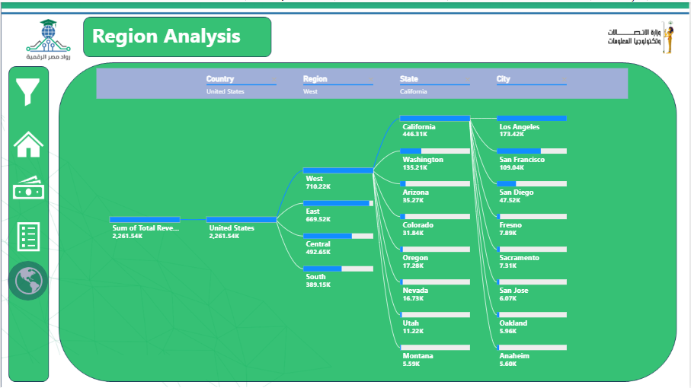
Region Analysis
VISION
Breaks down revenue across regions, countries, states, and cities to identify geographic opportunities and areas for improvement.

Slide 8
How we built the project
First stage (Data collection).
Collect data from datasets.
Check the Data quality. There are no Errors or data gaps.
Data type is quantitative Data.
Second stage (Power Query).
Change the format of Row ID to Text so as not to collect.
Change the order date format to the date with the locale origin.
Change the ship date format to the date with the locale origin.
Change the postal code format to Text so as not to collect.
Change the sales column name to revenue.
Change the revenue column format to a fixed decimal number.
Third Stage (Data Modeling).
Change the name of the table from (Superstore Sales Dataset) to (sales).
Duplicate sales table.
Remove columns (Customer Name + Segment) in the sales table.
Rename the new table to customers.
Keep columns (customer ID + customer name + segment) and remove other columns.
Remove duplicates from the customer ID column.
Duplicate sales table.
Rename the new table to products.
Keep columns (product ID+ Category+ Sub-Category+ Product Name) and remove other columns.
Remove duplicates from the product ID column.
Remove columns (Category + Sub-Category + Product Name) in the sales table.

Slide 9

Fourth Stage (Dax Calendar measure).
1Year Measure.
Quarter Measure.
Month Measure.
Weekly Measure.
Week of Month.
Week of Year.
YQM.
Weekday // Weekend.
Fifth Stage (Data Visualization Steps).
Visuals in Revenue Analysis Page.
Use Card new to visualize Total Revenue and Total Orders, Active Products.
Use Line chart to visualize Total Revenue by Year and Quarter.
Use Clustered bar chart to visualize Total Revenue by Customer Name.
Use Donut chart to visualize Total Revenue by Region.
Use Clustered bar chart to visualize Total Revenue by Segment.
Visuals in Product Analysis Page:
Use Card new to visualize Total Revenue and Total Orders, Active Products.
Use Donut chart to visualize Total Revenue by Category.
Use Clustered bar chart to visualize Total Revenue by Product Name.
Use Clustered columns chart to visualize Total Revenue by Sub-Category.
Visuals in Region Analysis Page:
Use Card new to visualize Total Revenue and Total Orders, Active Products.
Use Decomposition tree to visualize Total Revenue per region and country and state and City.

Slide 10
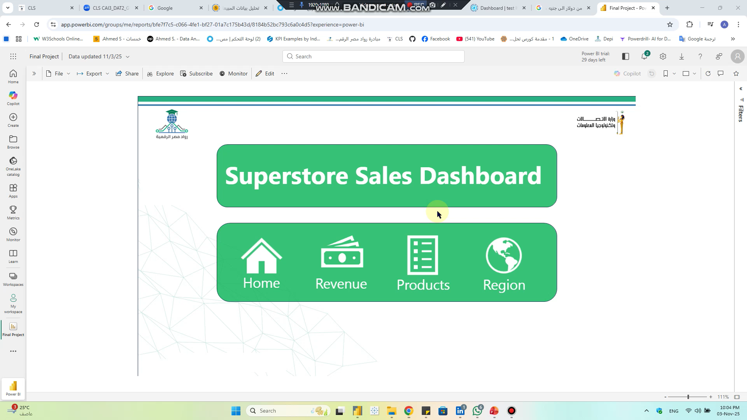

Project Summery

Slide 11
Thank You

